Slide 1
Float Point Number In MIPS

Slide 2
Objectives
• Examine float point registers
• know how to write float point arithmetic in MIPS

Slide 3


Floating-Point Representation
For single precision, the IEEE 754 encoding of floating numbers representation is shown below,
For double precision, the IEEE 754 encoding of floating numbers representation representation is shown below,
31 | 30 - 23 | 22 - 0
s
exponent
fraction
$${−1}^{s}× (1+fraction )×2^{exponent−127}$$
31 | 30 - 19 | 18 - 0
s
exponent
fraction
31 - 0
fraction
$${−1}^{s}× (1+fraction )×2^{exponent−1023}$$

Slide 4
Step 1
Transfer the floating numbers 0.128 into IEEE 754 encoding format(you can find an example in textbook page 201)(2points)
Single Precision:
0.875 =
Double Precision:
0.875 =

Slide 5
Step 2
Load Example1.s in your SPIM simulator
PS: you can find Example1.s in Blackboard
Run the program and fill out the ‘Single precision’ section of of Table 1 (the content of registers after program finished). The input you type at the keyboard when prompted will be the last four digits of your UWID, followed by a period (.), followed by the current year (four digits)
(2points)

Slide 6
Step 3
Load Example2.s in your SPIM simulator
PS: you can find Example2.s in Blackboard
Run the program and fill out the ‘double precision’ section of Table 1 (the content of registers after program finished). The input you type at the keyboard when prompted will be the last four digits of your UWID, followed by a period (.), followed by the current year (four digits)
(2points)

Slide 7
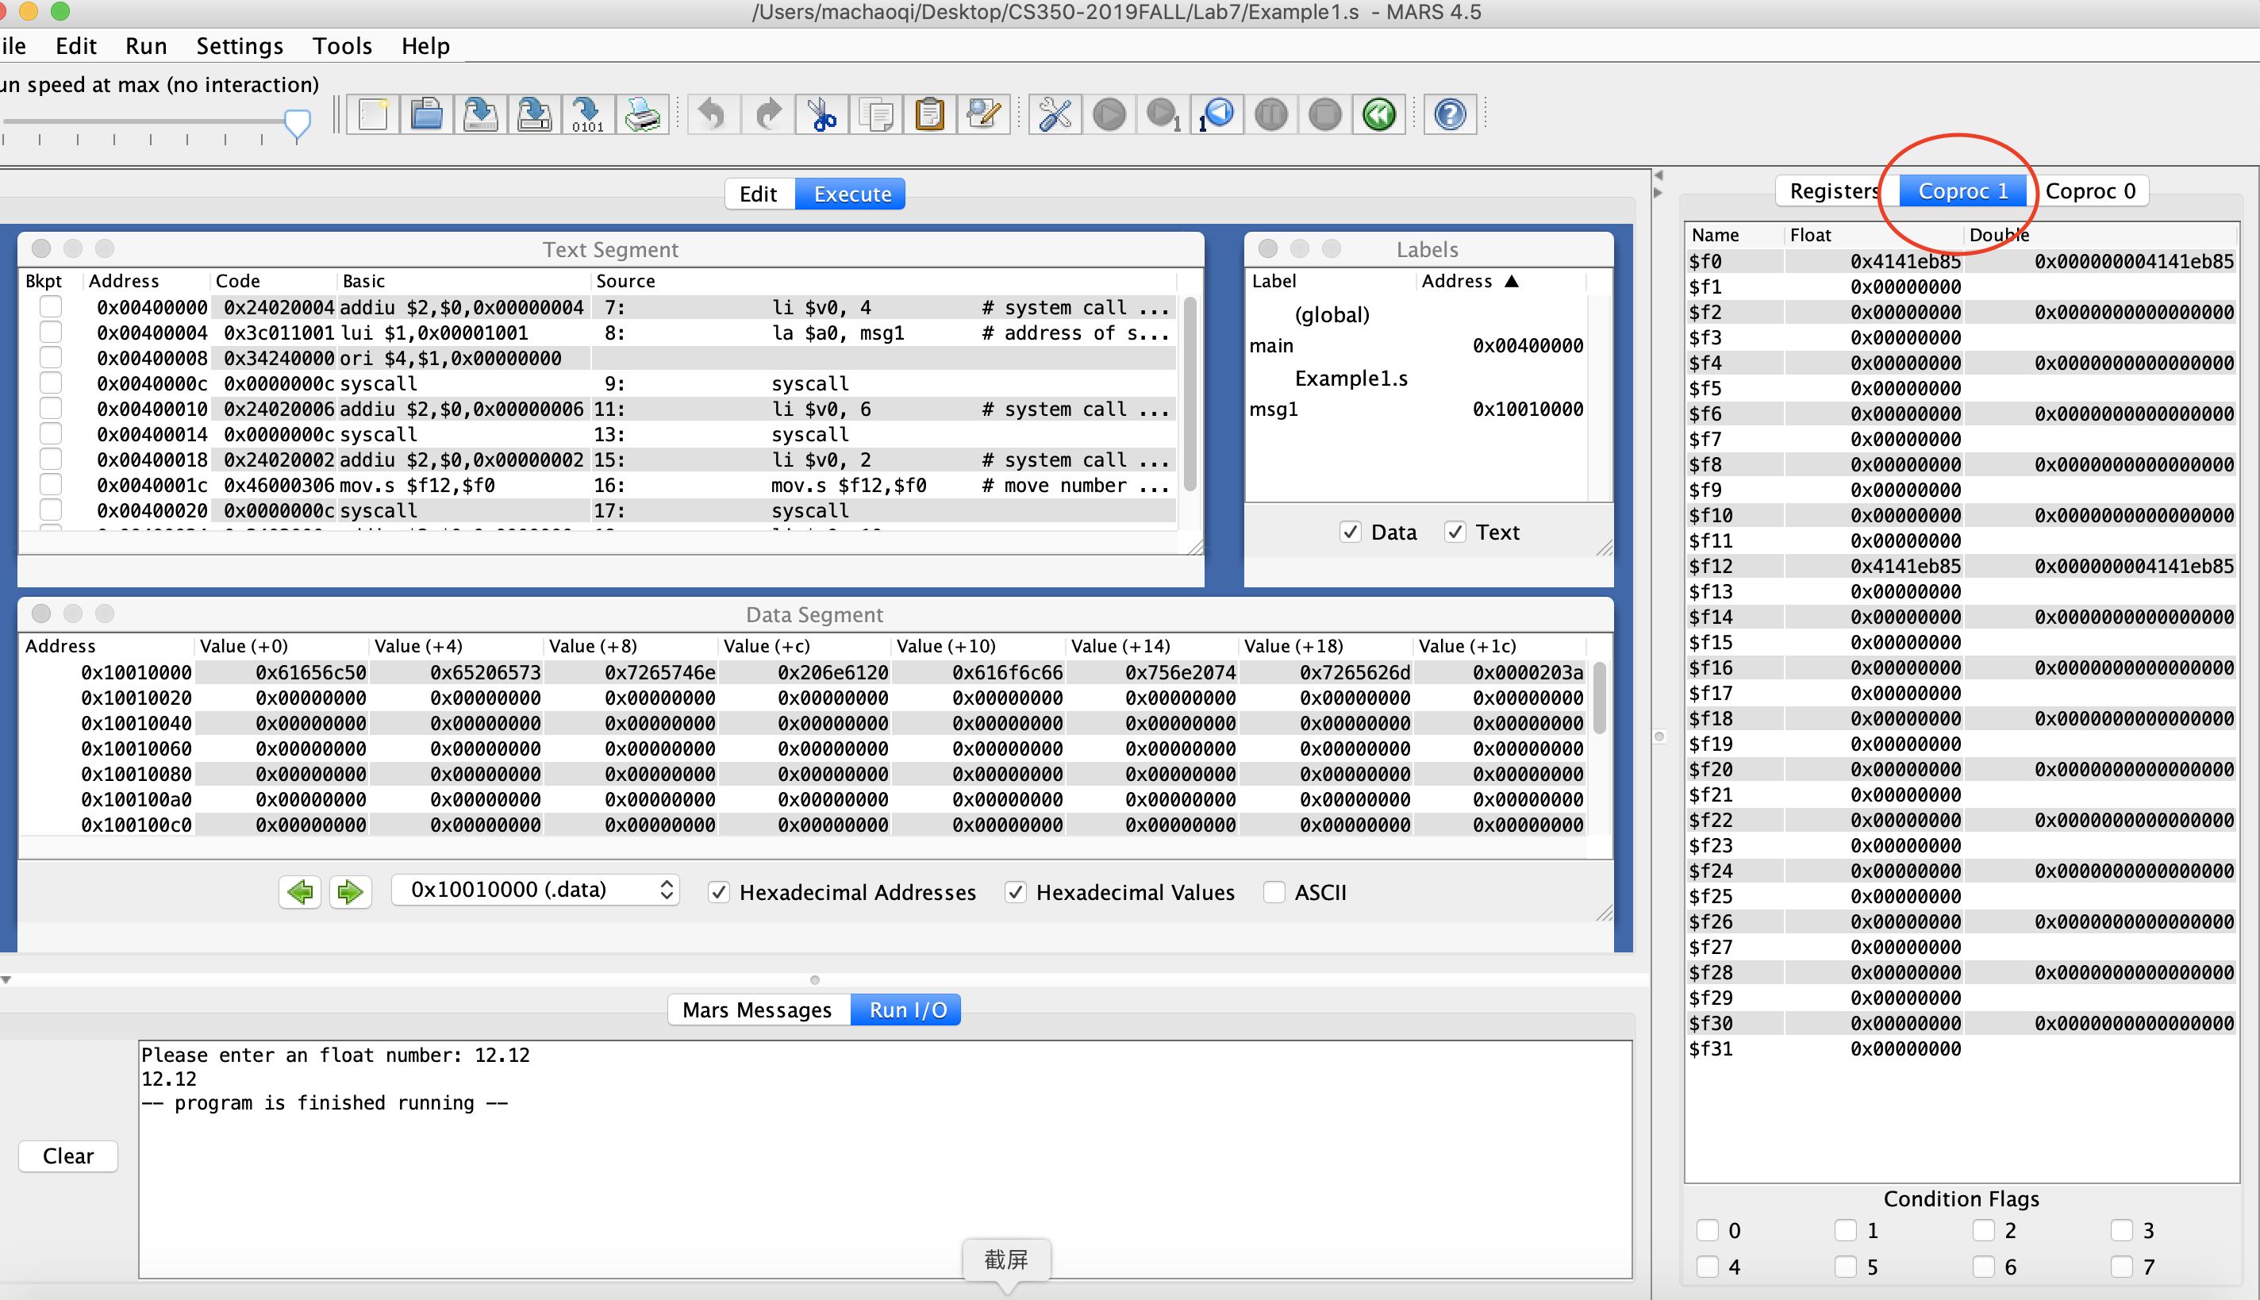
You can find the float registers here

Slide 8
Register | Single precision | Double precision
$f0
$f2
$f4
$f6
$f8
$f10
$f12
$f16
$f18
$f20
$f22
$f24
$f28
$f30
Table 1

Slide 9
Step 4
Input different value to see how to encode them in different type
(6points)
input | Single precision | Double precision
0
1
92
1.2
-0.128
-150.23456

Slide 10

Step 5
Based on lab7_Skeleton and create a program named lab7_1.asm which (8 points)
• calculate and print the results of the following formula:
$$a∙x^{2}+b∙y^{2} −c∙x∙y$$

Slide 11
Please answer all these questions in a sperate .doc file
Due: Next Friday

